Slide 1
Computer Vision
CNN Basics

Slide 2
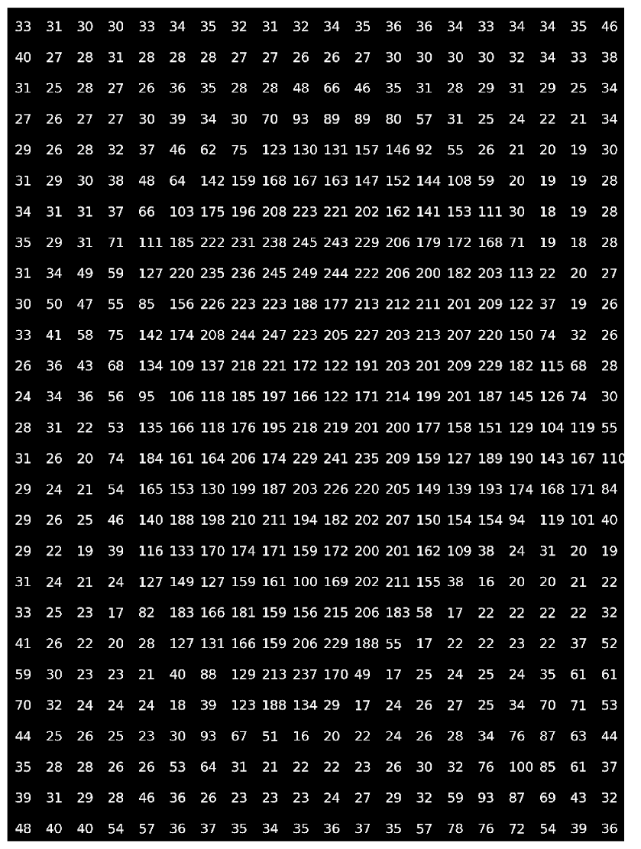
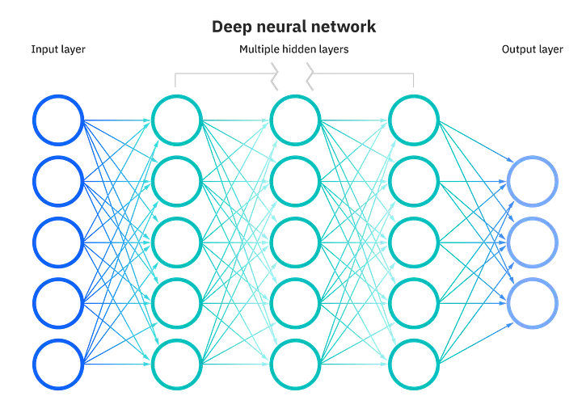
Can we make computer vision with NNs?
(n x m) input nodes
Source

Slide 3
Can we make computer vision with NNs?
Disadvantages:
For high resolution, huge amount of weights. Solution does not scale.
An image with a slight shift by one pixel, makes it no clear that will classify correctly
Usually, each pixel has a correlation with its neighbor pixels. We can not catch patterns

Slide 4
We need a robust solution: CNNs
Feature extraction
+

Slide 5
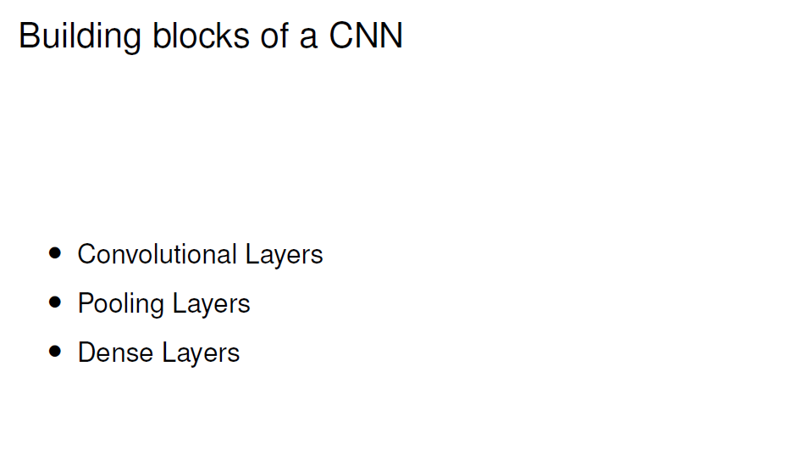
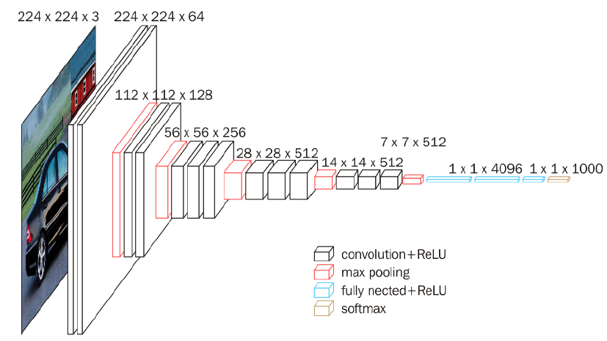

Slide 6
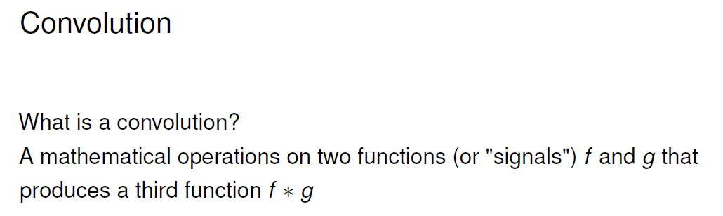
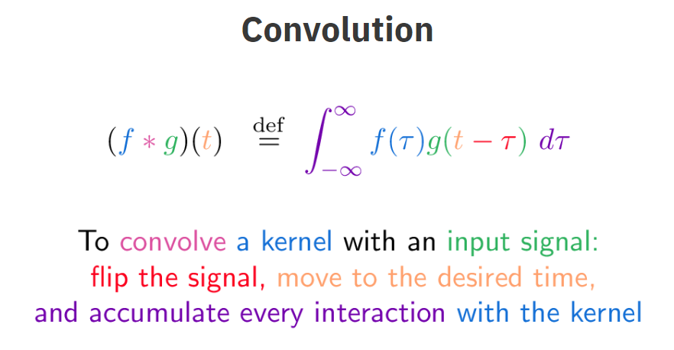

Slide 7
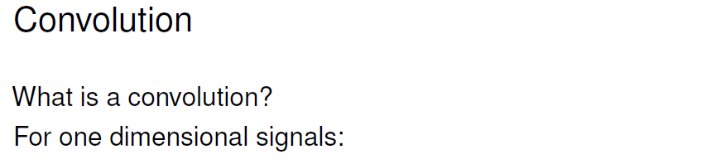
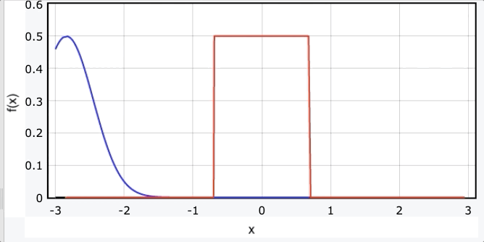
Source

Slide 8
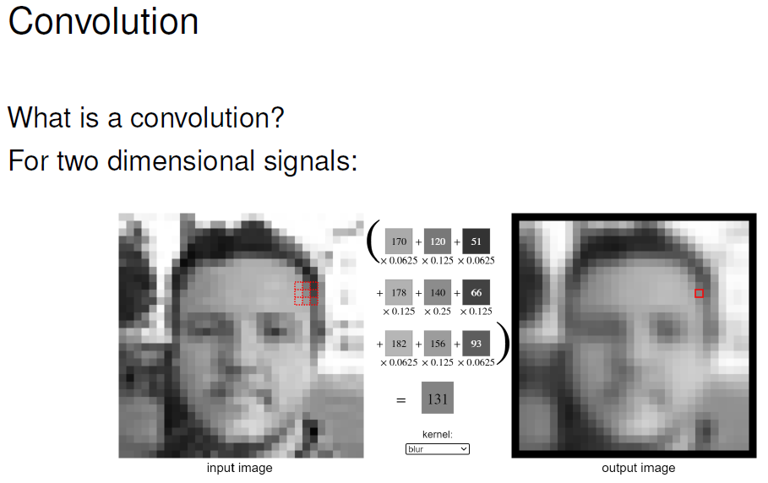
https://setosa.io/ev/image-kernels/

Slide 9
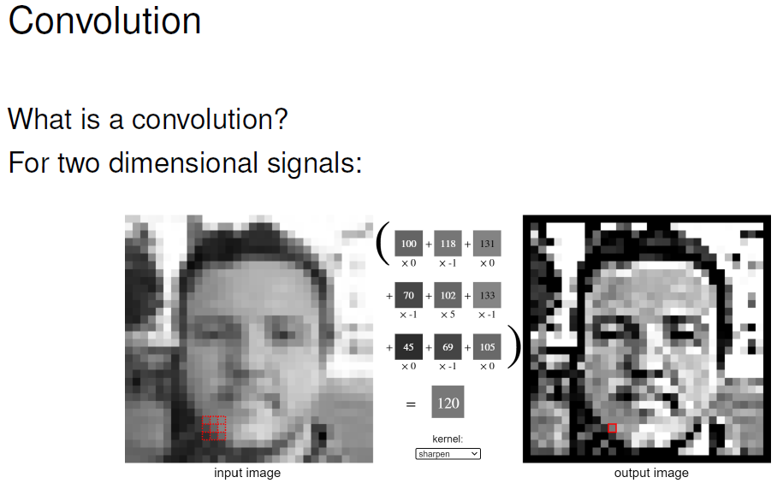

Slide 10
Advantages using Convolution
Reduce the number of input nodes (less computations).
Tolerate shifts on the images.
Take advantage of the pixel correlation in complex images.

Slide 11
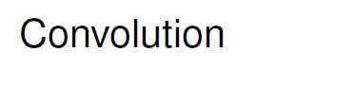
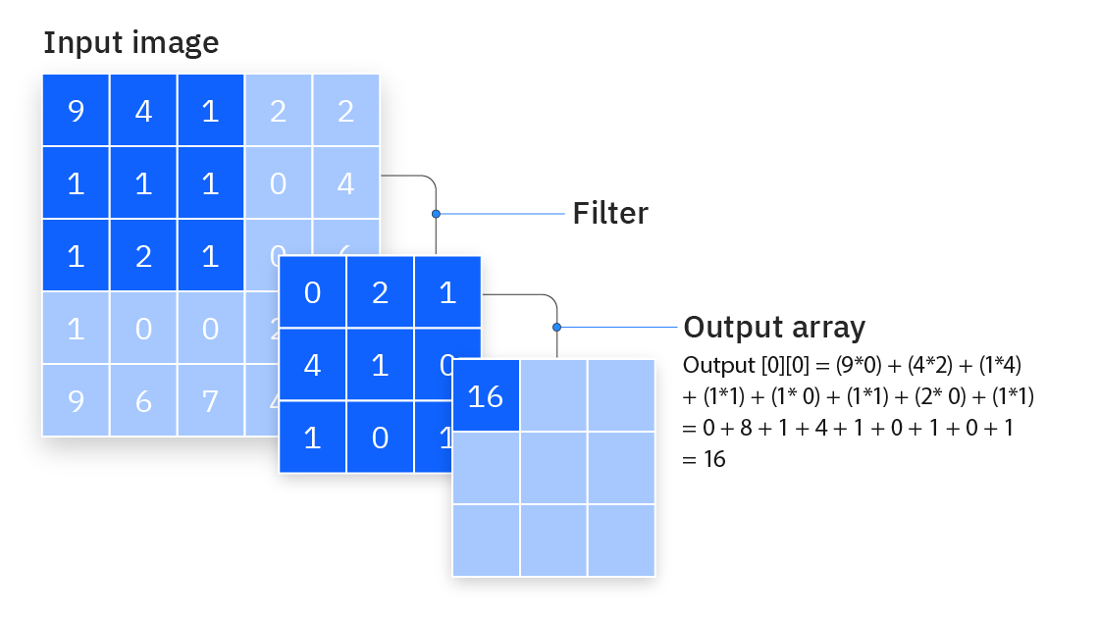
Source

Slide 12
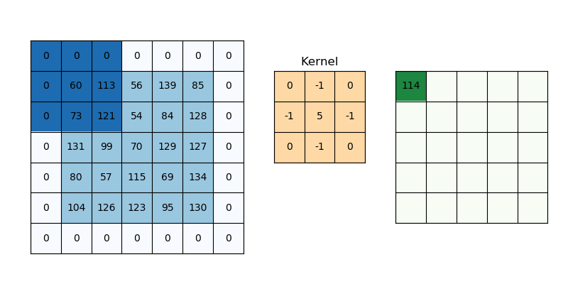
Padding
Source

Slide 13


Slide 14
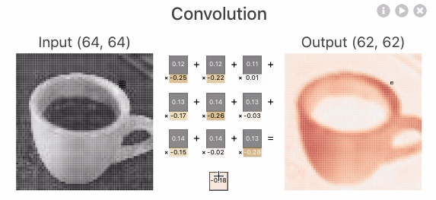
Source

Slide 15
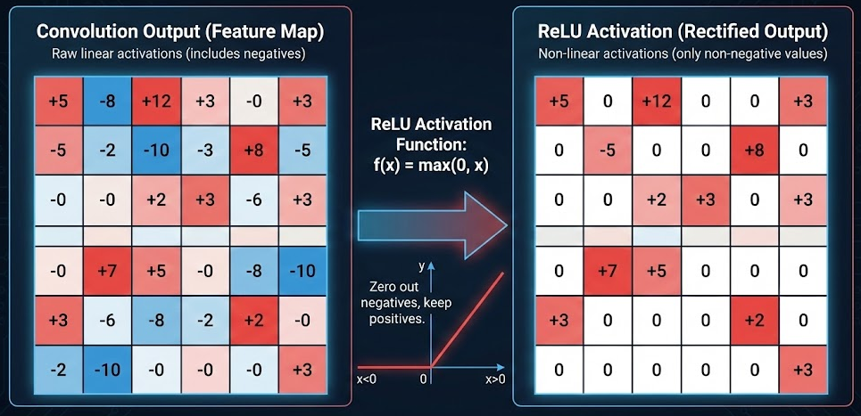
Activation function

Slide 16
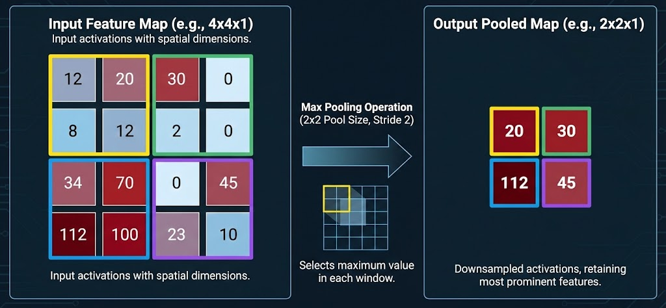
Pooling Layer
No parameters
Dimensionality reduction
Regularization
Lost location information

Slide 17
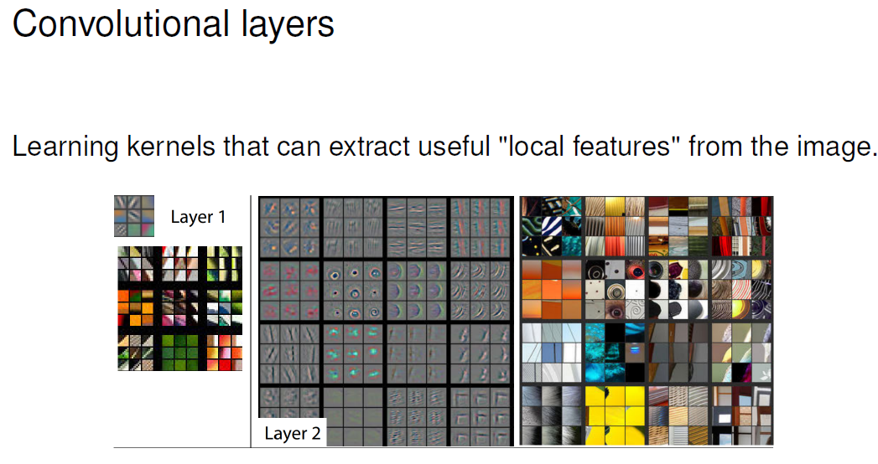

Slide 18
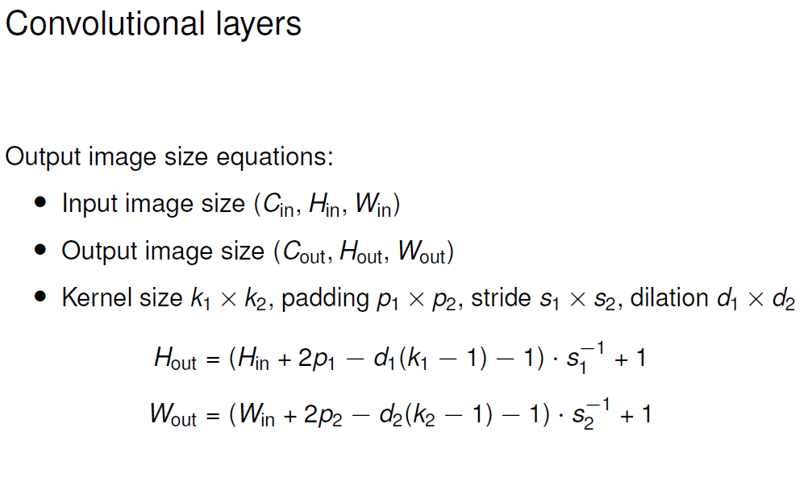

Slide 19
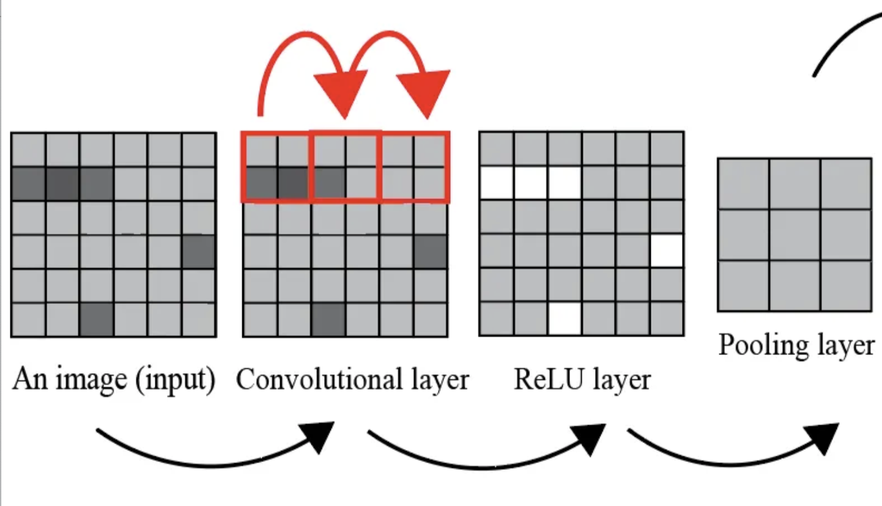
Put all together
Source

Slide 20
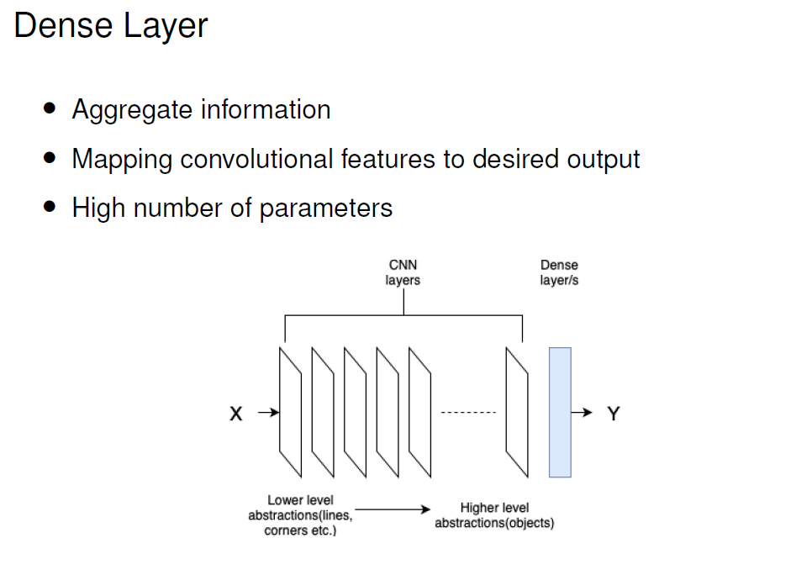

Slide 21

Feature extraction
Source

Slide 22
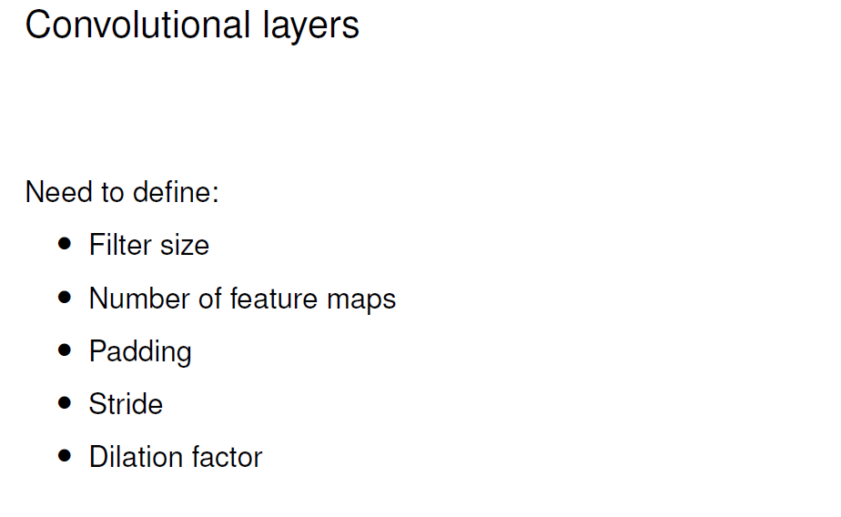
https://github.com/vdumoulin/conv_arithmetic
https://d2l.ai/chapter_convolutional-neural-networks/conv-layer.html
https://stanford.edu/~shervine/teaching/cs-230/cheatsheet-convolutional-neural-networks#layer

Slide 23
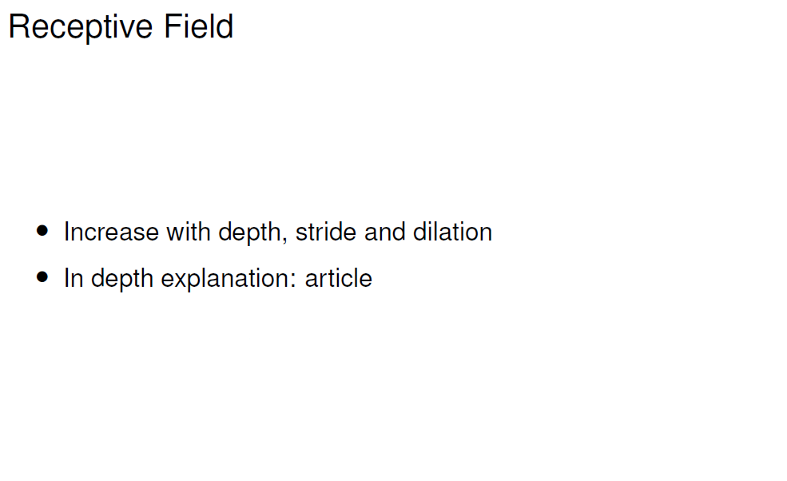
In a CNN, each layer "looks at" the output of the previous layer. As you go deeper into the network, the receptive field of the neurons grows.
A neuron in a deep layer might be influenced by a large portion or even all, of the original input image, even though it's only directly looking at a small patch of the layer before it.
Source

Slide 24
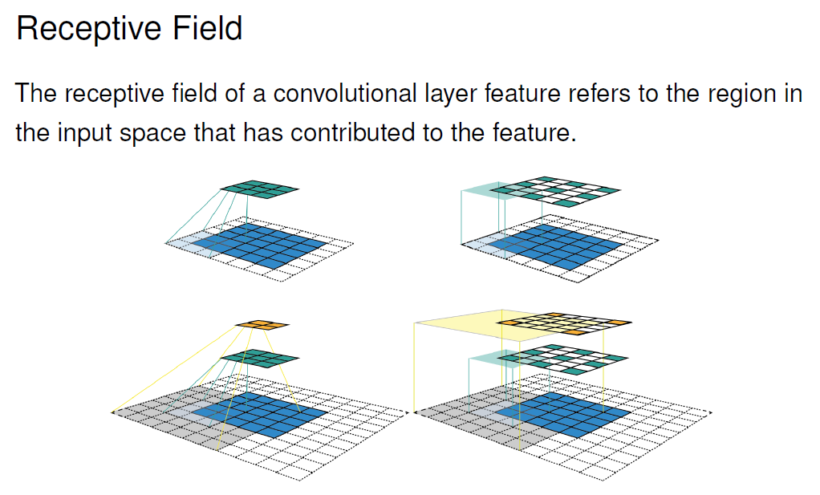

Slide 25
Code Discussion
Convolution & Intro to PyTorch

